Slide 1
Set Up GoDaddy Email
Lecturer: Ngo Huy Bien
Software Engineering Department
Faculty of Information Technology
VNUHCM - University of Science
Ho Chi Minh City, Vietnam
nhbien@fit.hcmus.edu.vn

Slide 2

Objectives

Slide 3

Contents

Slide 4

References

Slide 5
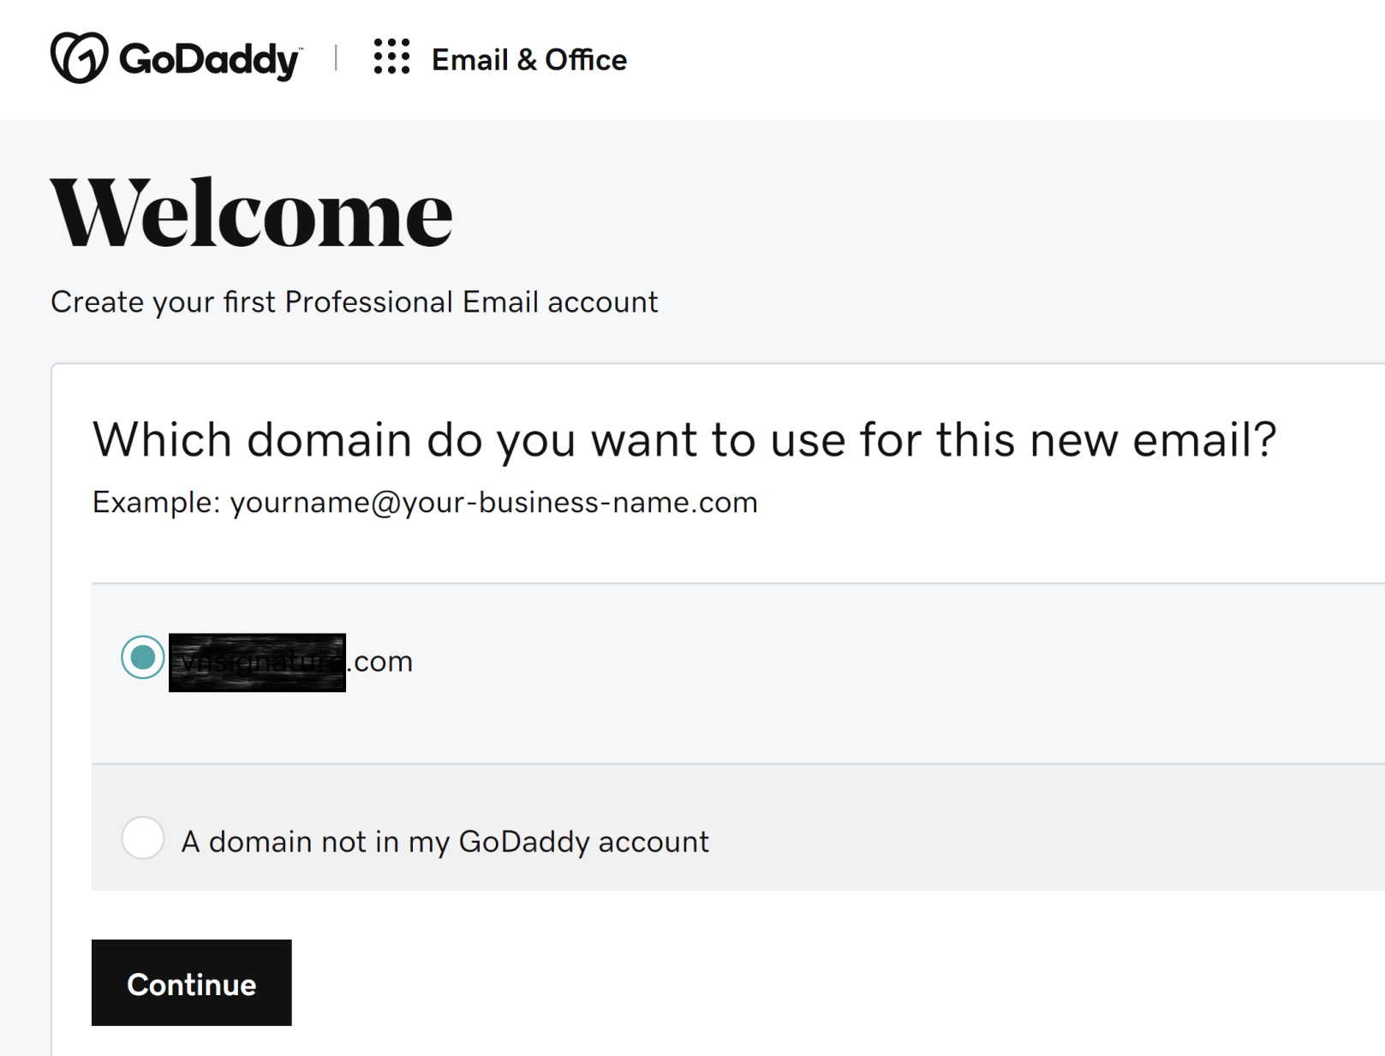
1. Select Domain

Slide 6
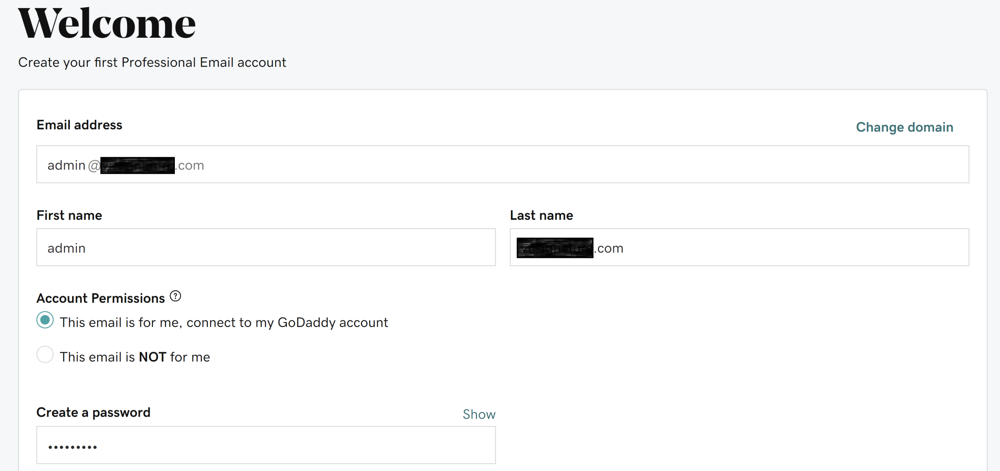
2. Create an (admin) Account

Slide 7
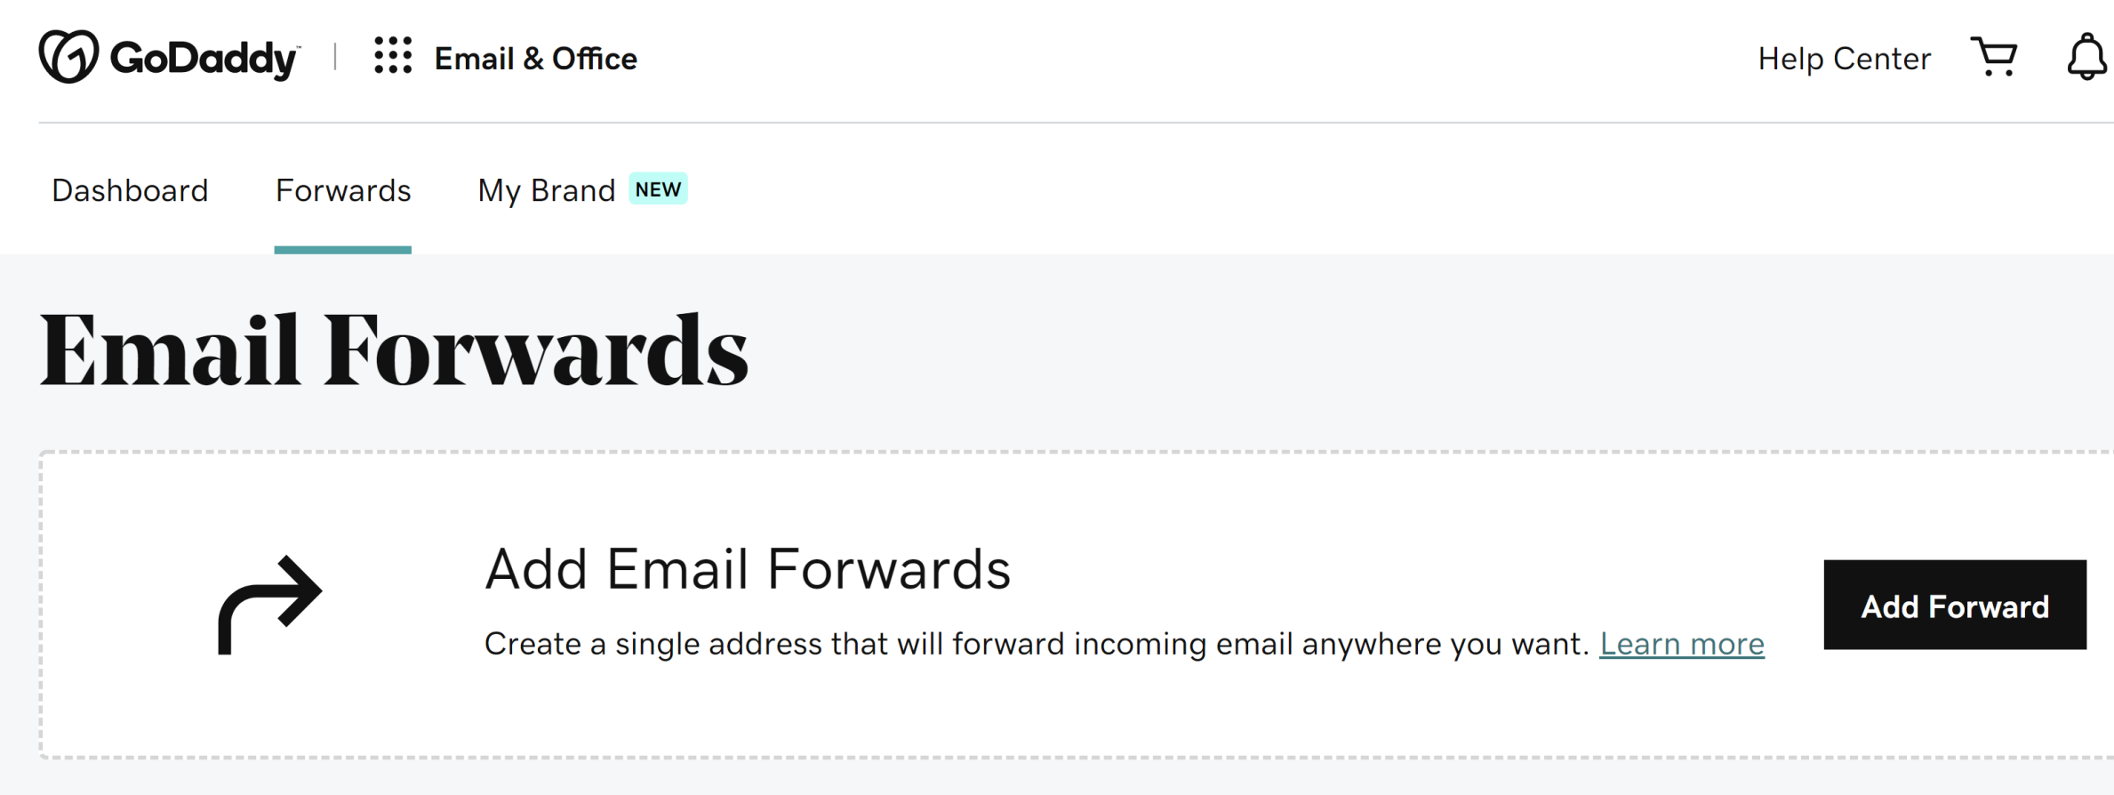
3. Add Email Forwards (I)

Slide 8
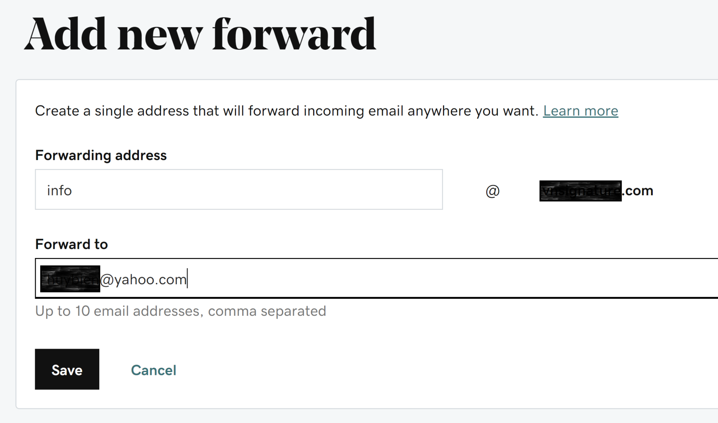
4. Add Email Forwards (I)

Slide 9

Thank You & See You Again

